Slide 1
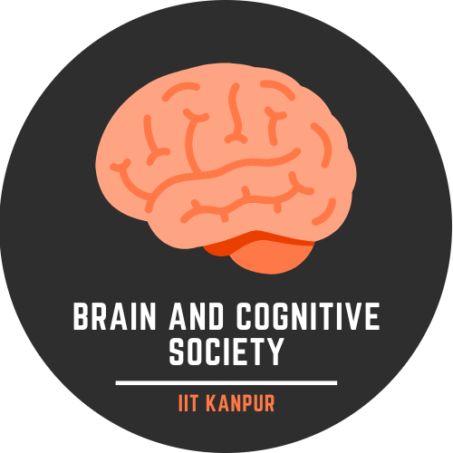

ANALYSING BRAINS AND DNNs FOR IMAGES AND COLOR
Dravya Marwaha
Deeksha Vijay
Diksha Banka
Gaurvika Kapoor
Praveen Prabhat
Twinkle Arora
Mentor: Shivi Gupta

Slide 2
Objective and Overview
Dataset and Toolbox
Experiments Carried out
Classification Task
Results and discussion

Slide 3
Objective and Overview
Convolutional neural networks (CNNs) have made great advances in the computer vision fields. In this analysis, we study representation of colors in CNNs and in brains using the Python toolbox DNNBrain.
We started with a literature survey, studying papers on how colors are perceived by humans and macaque brains. Then we moved to the DNNBrain toolbox, using its functionality to study how CNNs encode images as well as colors. We carry out a number of experiments (provided by DNNBrain) to do this. Finally, we carry out a classification task on color classes. Here we analyse two methods:
Transfer learning
Learning from scratch
Our hypothesis is that transfer learning will give better classification accuracy since features are extracted from CNNs which already contain some information of the input picture, as seen from the experiments carried out.

Slide 4
Dataset And Toolbox
Toolbox : DNNBrain is a modular python toolbox to integrate DNN software packages and brain mapping tools. It integrates representations of DNNs and the neural representations of the brain. It assembles stimuli, artificial activity data, and biological neural activity data together, helping in comparing representations of DNNs and brains.
AlexNet model was primarily used as our DNN model which consists of eight layers and learnable parameters. The architecture is composed of five convolutional layers and three fully connected layers that receives inputs from all units in previous layer followed by a 1000 way softmax classifier.
Dataset : BOLD5000 is a large-scale publicly available dataset of practical study of human FMRI with 5000 real-world images as stimuli, which also accounts for image diversity and overlapping with standard computer vision datasets by incorporating images from the Scene Understanding (SUN), Common Objects in Context (COCO), and ImageNet datasets.

Slide 5
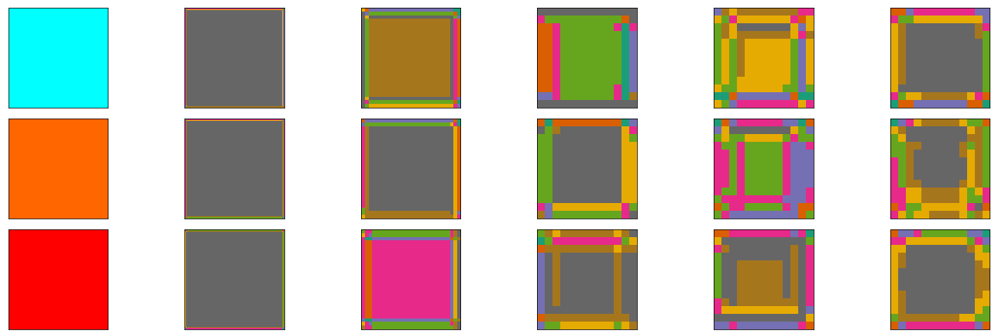
Experiments
Many experiments were carried out to study the encoding of images in CNNs and correlations between CNNs and brains. Here we report only the ones we were able to extend to color inputs.
ScanDNN
To understand the perception of colors by the DNN, we passed plain color images in the DNN and observed the representations in different convolutional layers. From the result, it was evident that the initial layers perceive the colors more or less the same but as we go deeper, it starts differentiating the colors as shown in the figure below.

Slide 6
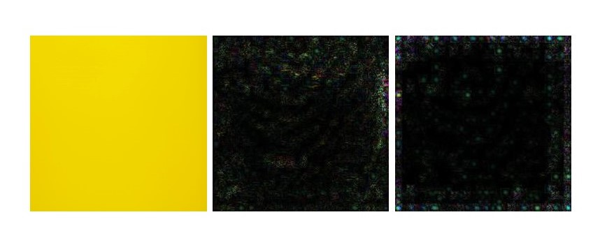
Experiments
2. Saliency Image :
It highlights pixels of the image that increase the unit’s activation most when its value changes.The purpose of the saliency map is to find the regions which are prominent or noticeable at every location in the visual field and to guide the selection of attended locations, based on the spatial distribution of saliency. Saliency image for a color input is shown below.

Slide 7
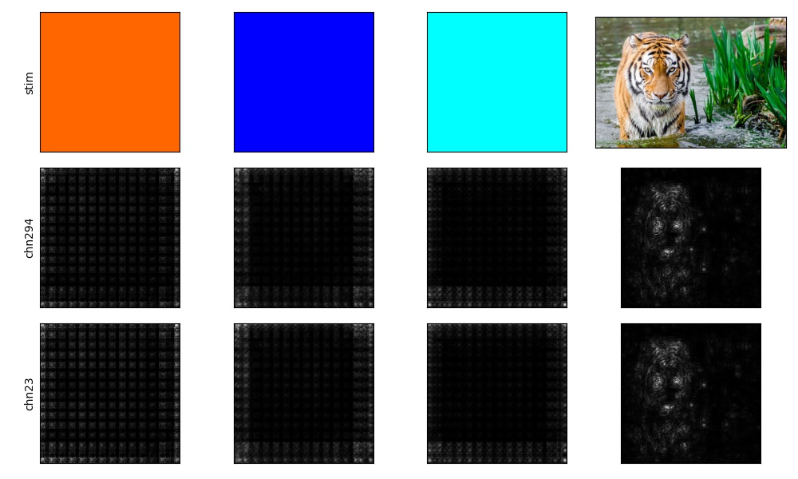
Experiments
3. Minimal Image
It is a way to simplify a stimulus into a minimal part which could cause almost equivalent activation as the original stimulus for a DNN unit. Some minimal images for colors are shown below.

Slide 8
Classification Task
A classification task is carried out for a dataset consisting of colors. Our hypothesis is that transfer learning will give better accuracies than the model which learns from scratch. We test this hypothesis.
We used two major transfer learning scenarios.
Fixed feature extractor: Here, we replace the last fully-connected layer, replacing it with a linear layer, training just this layer for classification.
Fine tuning: The model remains same as above, but the losses are propagated backwards, fine-tuning the layers of the DNN itself.
Generating the dataset: To check the performance of both the models, we generated a dataset by creating images using different RGB values and creating numpy arrays using these RGB values. We generated 11 Basic Color Categories for Classification and labelled around 5000 RGB colors.

Slide 9
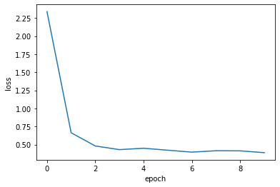
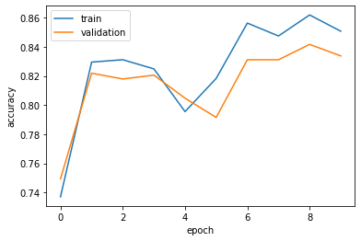
Learning from Scratch
We defined a DNN which consisted one convolutional layer and two fully connected layers along with ReLU activation and 2D Max-Pooling. This model is designed to receive a tensor with shape as (n_sample, 3, 224, 224), and do the classification. Given below are the results obtained.

Slide 10
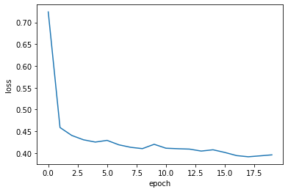
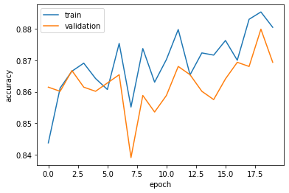
Transfer Learning - Feature Extractor
Here, we replace the last fully-connected layer, replacing it with a linear layer, training just this layer for classification.

Slide 11
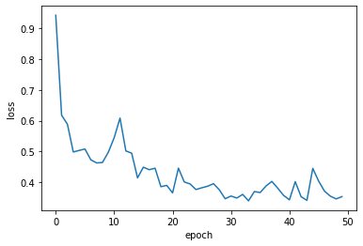
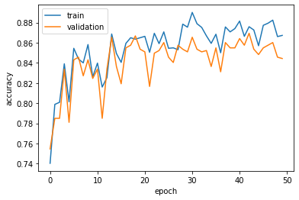
Transfer Learning - Finetuning
The model remains same as earlier, but the losses are propagated backwards, fine-tuning the layers of the DNN itself. Due to overfitting concerns, instead of fine-tuning all the layers of the ConvNet, we kept some of the earlier layers fixed and only fine-tuned some higher-level portion of the network.

Slide 12
Comparison in the Models
Following are the results we obtained
Model | Train:Test Split | Train Accuracy | Test Accuracy
Learning from Scratch | 0.85:0.15 | 0.85 | 0.83
Transfer Learning (Feature Extractor) | 0.85:0.15 | 0.88 | 0.87
Transfer Learning (Fine-Tuning) | 0.85:0.15 | 0.86 | 0.85
Notes:
Learning from Scratch

Slide 13
Results and Discussion
We carried out an analysis for convolutional neural networks (AlexNet), looking at how images are encoded in different layers with the help of various experiments. We extended these analysis to color inputs, which showed how CNNs don't work quite the same compared to when there are salient parts present in the image. This is because CNNs are based on looking at shapes and edges present in the image. Though this still does not prove whether it does not contain any information for color images.
To test this, we carried out a classification task for a dataset just containing color images by two methods. Training from scratch and transfer learning. Comparing the accuracy scores, it is clear that transfer learning performed better. This is because the DNN does indeed contain usable information of the color images, which helps in distinguishing one color from the other. And this shows that CNNs do encode information to differentiate between colors.

Slide 14
Thank you

